Slide 1
Large Language Model
Instructor name: Shukdev datta
Ml developer at innovative skills

Slide 2
What is a large language model (LLM)?
A large language model (LLM) is a type of artificial intelligence (AI) program that can recognize and generate text, among other tasks. LLMs are trained on huge sets of data — hence the name "large." LLMs are built on machine learning: specifically, a type of neural network called a transformer model.
In simpler terms, an LLM is a computer program that has been fed enough examples to be able to recognize and interpret human language or other types of complex data. Many LLMs are trained on data that has been gathered from the Internet — thousands or millions of gigabytes' worth of text. But the quality of the samples impacts how well LLMs will learn natural language, so an LLM's programmers may use a more curated data set.
LLMs use a type of machine learning called deep learning in order to understand how characters, words, and sentences function together. Deep learning involves the probabilistic analysis of unstructured data, which eventually enables the deep learning model to recognize distinctions between pieces of content without human intervention.
LLMs are then further trained via tuning: they are fine-tuned or prompt-tuned to the particular task that the programmer wants them to do, such as interpreting questions and generating responses, or translating text from one language to another.

Slide 3
What is a large language model (LLM)?
A large language model is an advanced type of language model that is trained using deep learning techniques on massive amounts of text data. These models are capable of generating human-like text and performing various natural language processing tasks.
In contrast, the definition of a language model refers to the concept of assigning probabilities to sequences of words, based on the analysis of text corpora.
A language model can be of varying complexity, from simple n-gram models to more sophisticated neural network models.
However, the term “large language model” usually refers to models that use deep learning techniques and have a large number of parameters, which can range from millions to billions.
These models can capture complex patterns in language and produce text that is often indistinguishable from that written by humans.

Slide 4
What are LLMs used for?
LLMs can be trained to do a number of tasks. One of the most well-known uses is their application as generative AI: when given a prompt or asked a question, they can produce text in reply. The publicly available LLM ChatGPT, for instance, can generate essays, poems, and other textual forms in response to user inputs.
Any large, complex data set can be used to train LLMs, including programming languages. Some LLMs can help programmers write code. They can write functions upon request — or, given some code as a starting point, they can finish writing a program. LLMs may also be used in:
Sentiment analysis
DNA research
Customer service
Chatbots
Online search
Examples of real-world LLMs include ChatGPT (from OpenAI), Bard (Google), Llama (Meta), and Bing Chat (Microsoft). GitHub's Copilot is another example, but for coding instead of natural human language.

Slide 5
What are some advantages and limitations of LLMs?
A key characteristic of LLMs is their ability to respond to unpredictable queries. A traditional computer program receives commands in its accepted syntax, or from a certain set of inputs from the user.
A video game has a finite set of buttons, an application has a finite set of things a user can click or type, and a programming language is composed of precise if/then statements.
By contrast, an LLM can respond to natural human language and use data analysis to answer an unstructured question or prompt in a way that makes sense.
Whereas a typical computer program would not recognize a prompt like "What are the four greatest funk bands in history?", an LLM might reply with a list of four such bands, and a reasonably cogent defense of why they are the best.

Slide 6
What are some advantages and limitations of LLMs?
In terms of the information they provide, however, LLMs can only be as reliable as the data they ingest. If fed false information, they will give false information in response to user queries.
LLMs also sometimes "hallucinate": they create fake information when they are unable to produce an accurate answer.
For example, in 2022 news outlet Fast Company asked ChatGPT about the company Tesla's previous financial quarter; while ChatGPT provided a coherent news article in response, much of the information within was invented.
In terms of security, user-facing applications based on LLMs are as prone to bugs as any other application. LLMs can also be manipulated via malicious inputs to provide certain types of responses over others — including responses that are dangerous or unethical.
Finally, one of the security problems with LLMs is that users may upload secure, confidential data into them in order to increase their own productivity.
But LLMs use the inputs they receive to further train their models, and they are not designed to be secure vaults; they may expose confidential data in response to queries from other users.

Slide 7
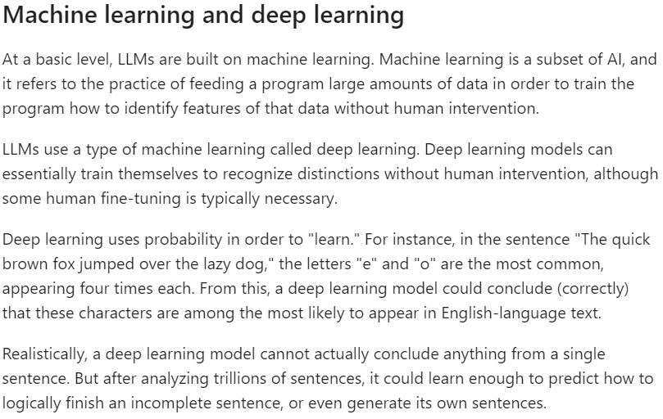
How do LLMs work?

Slide 8
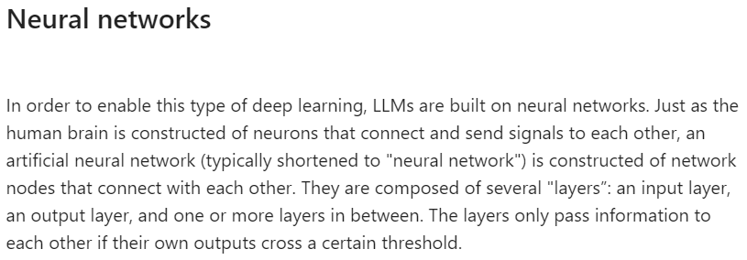
How do LLMs work?

Slide 9
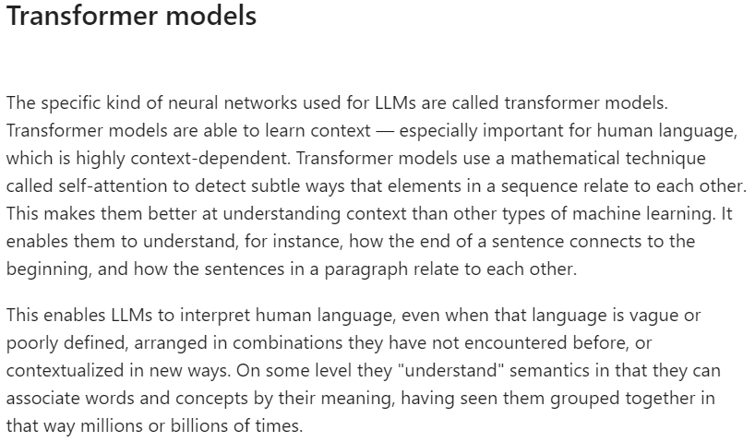
How do LLMs work?

Slide 10
How a Large Language Model (LLM) Is Built?
A large-scale transformer model known as a “large language model” is typically too massive to run on a single computer and is, therefore, provided as a service over an API or web interface. These models are trained on vast amounts of text data from sources such as books, articles, websites, and numerous other forms of written content. By analyzing the statistical relationships between words, phrases, and sentences through this training process, the models can generate coherent and contextually relevant responses to prompts or queries.
ChatGPT’s GPT-3, a large language model, was trained on massive amounts of internet text data, allowing it to understand various languages and possess knowledge of diverse topics. As a result, it can produce text in multiple styles. While its capabilities, including translation, text summarization, and question-answering, may seem impressive, they are not surprising, given that these functions operate using special “grammars” that match up with prompts.

Slide 11
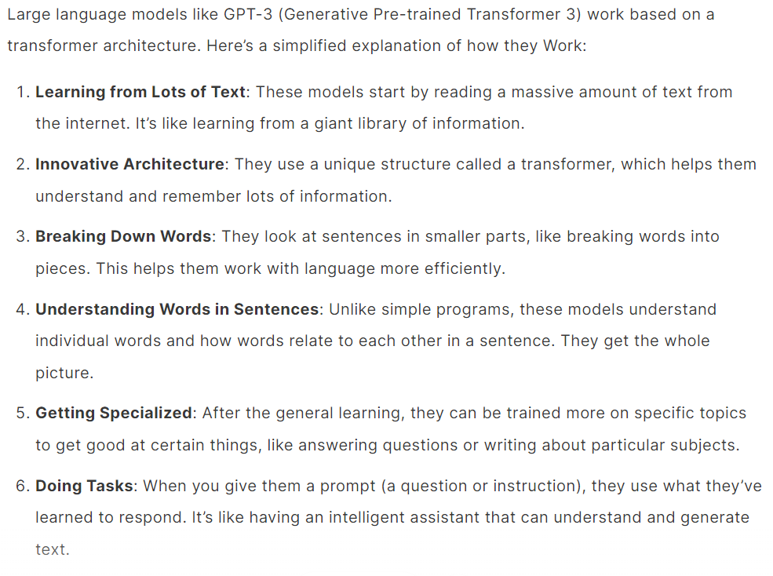
Steps involved in LLM working principal

Slide 12
Difference Between Large Language Models and Generative AI:
Generative AI is like a big playground with lots of different toys for making new things. It can create poems, music, pictures, even invent new stuff!
Large Language Models are like the best word builders in that playground. They’re really good at using words to make stories, translate languages, answer questions, and even write code!
So, generative AI is the whole playground, and LLMs are the language experts in that playground.

Slide 13
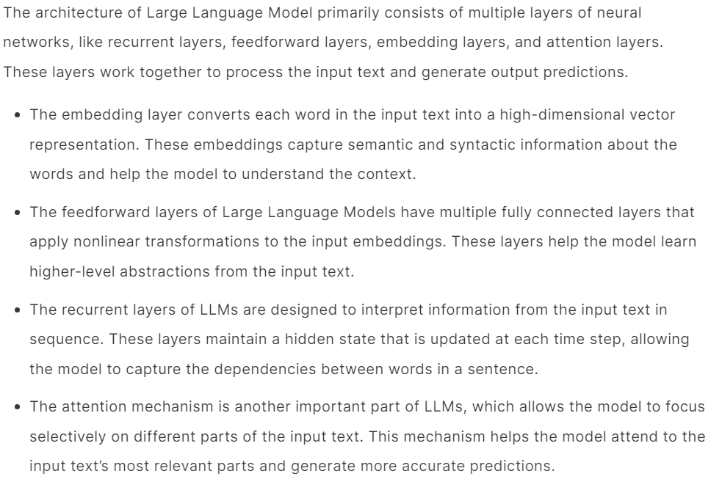
General Architecture of LLM

Slide 14
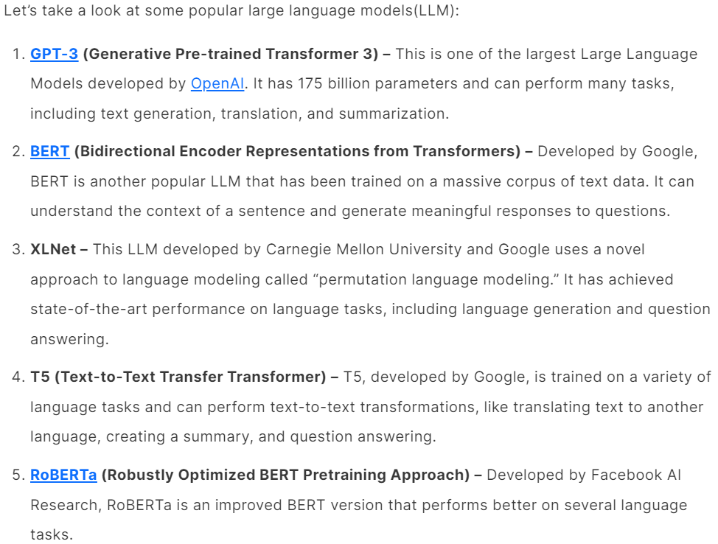
Examples of LLMs

Slide 15
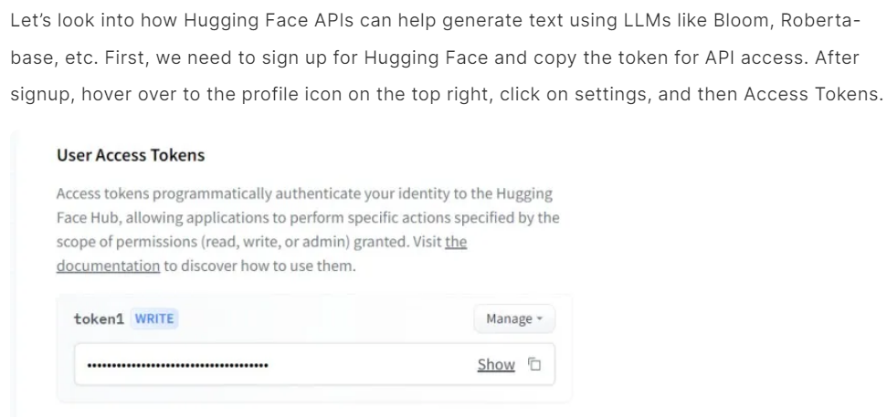
Hugging Face APIs

Slide 16
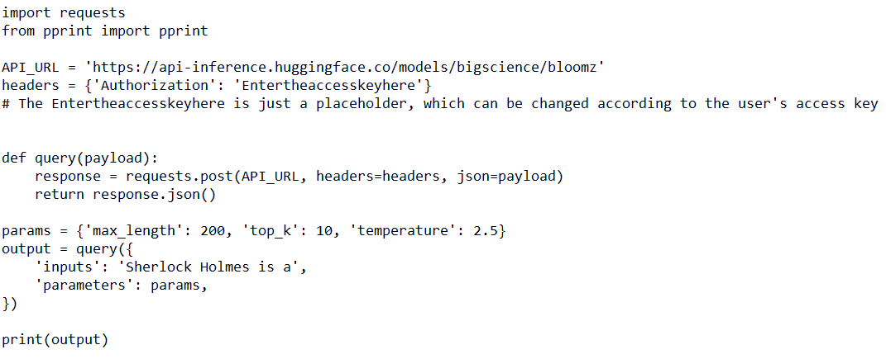
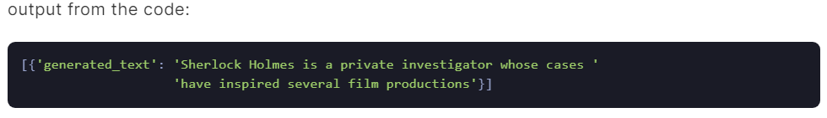
Example 1: Sentence Completion
Let’s look at how we can use Bloom for sentence completion. The code below uses the hugging face token for API to send an API call with the input text and appropriate parameters for getting the best response.

Slide 17
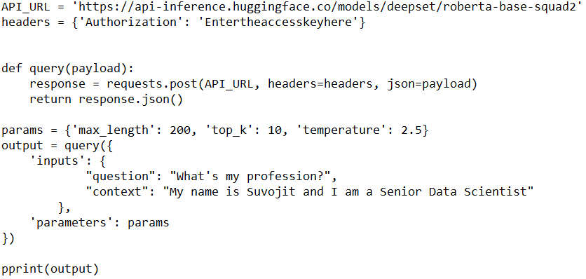
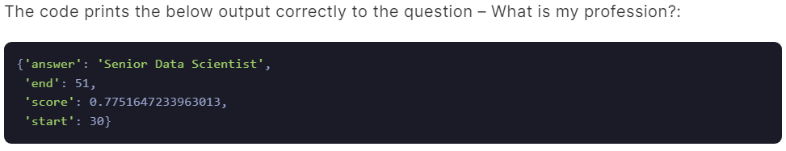
Example 2: Question Answers
We can use the API for the Roberta-base model which can be a source to refer to and reply to. Let’s change the payload to provide some information about myself and ask the model to answer questions based on that.

Slide 18
Example 3: Summarization
We can summarize using Large Language Models. Let’s summarize a long text describing large language models using the Bart Large CNN model. We modify the API URL and added the input text below:

Slide 19
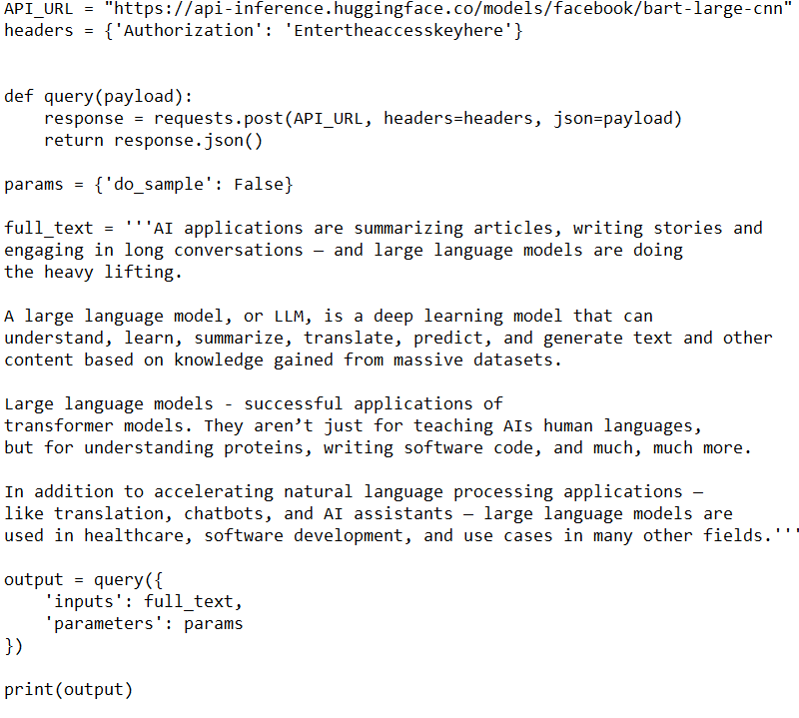
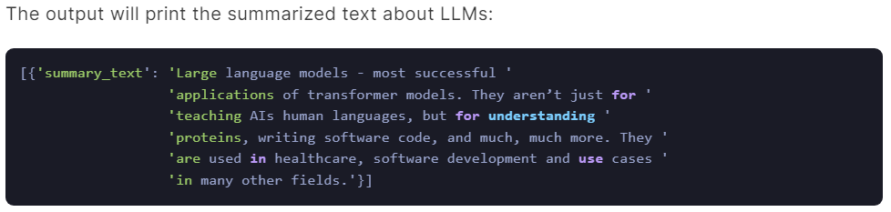
Example 3: Summarization

Slide 20
Future Implications of LLMs
In recent years, there has been specific interest in large language model (LLMs) like GPT-3, and chatbots like ChatGPT, which can generate natural language text that has very little difference from that written by humans. While LLMs have seen a breakthrough in the field of artificial intelligence (AI), there are concerns about their impact on job markets, communication, and society.
One major concern about LLMs is their potential to disrupt job markets. Large Language Model, with time, will be able to perform tasks by replacing humans like legal documents and drafts, customer support chatbots, writing news blogs, etc. This could lead to job losses for those whose work can be easily automated.

Slide 21
Future Implications of LLMs
However, it is important to note that LLMs are not a replacement for human workers. They are simply a tool that can help people to be more productive and efficient in their work. While some jobs may be automated, new jobs will also be created as a result of the increased efficiency and productivity enabled by LLMs. For example, businesses may be able to create new products or services that were previously too time-consuming or expensive to develop.
LLMs have the potential to impact society in several ways. For example, LLMs could be used to create personalized education or healthcare plans, leading to better patient and student outcomes. LLMs can be used to help businesses and governments make better decisions by analyzing large amounts of data and generating insights.

Slide 22
Thank You!!!

